Slide 1
Hate Crimes in the United States of America
STAT 515- Visualization for Analytics

Slide 2
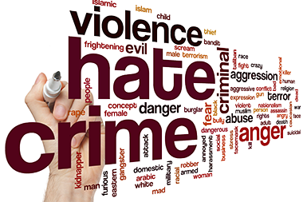
CRIME:
WHEN
WHY
HOW

Slide 3
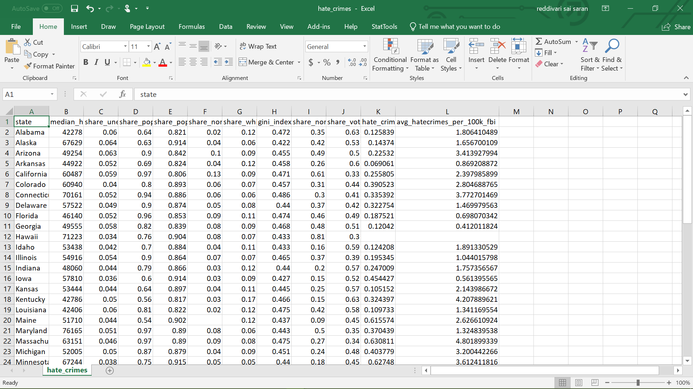
DATA SET:

Slide 4
ATTRIBUTES:
Attribute | Definition
state | State name
median_household_income | Median household income, 2016
share_unemployed_seasonal | Share of the population that is unemployed, Sept. 2016
share_population_in_metro_areas | Share of the population that lives in metropolitan areas, 2015
share_population_with_high_school_ degree | Share of adults 25 and older with a high-school degree, 2009
share_non_citizen | Share of the population that are not U.S citizens, 2015
share_white_poverty | Share of white residents who are living in poverty 2015
gini_index | Gini index, 2015
share_non_white | Share of the population that is not white, 2015
share_voters_voted_trump | Share of 2016 U.S. preseidential voters who voted for Donald trump
hate_crimes_per_100k_splc | Hate crimes per 100,000 population, southern poverty law center, Nov. 9-18, 2016
avg_hatecrimes_per_100k_fbi | Average annual hate crimes per 100,000 population, FBI, 2010-2015

Slide 5
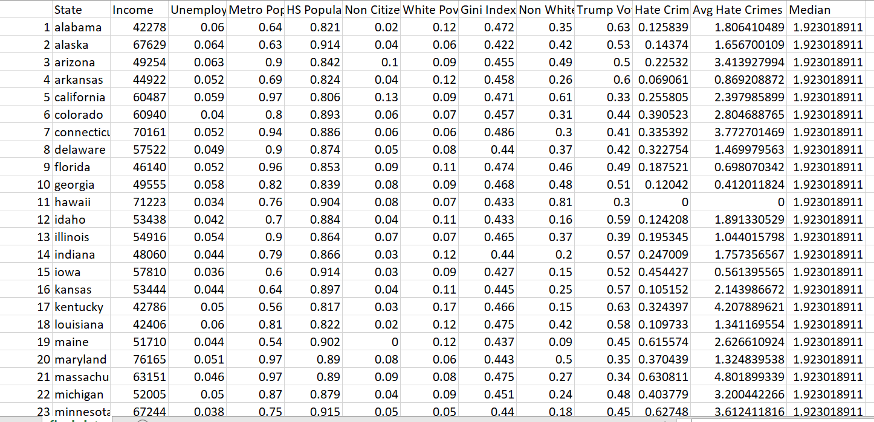
Cleaned Data Set:

Slide 6
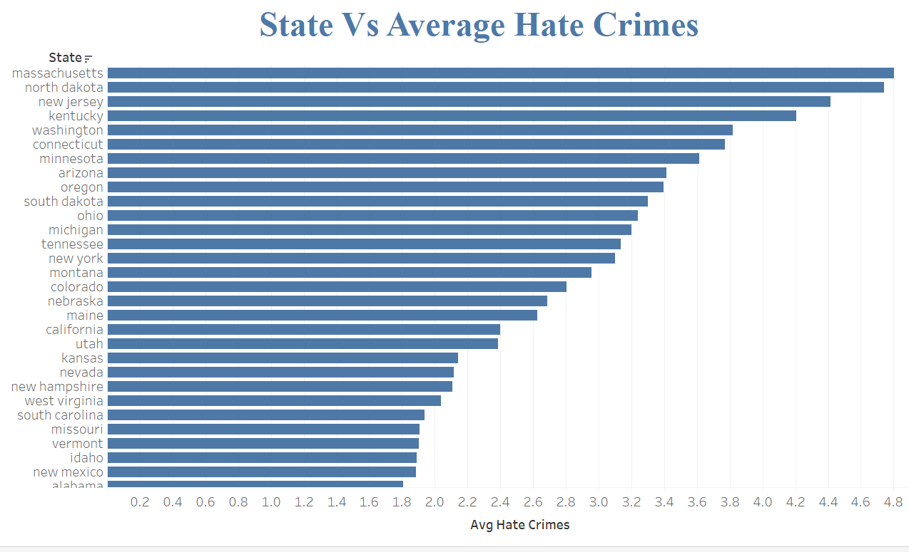
BAR GRAPH:
Massachusetts has the highest average hate crime rate.
Alabama has the least hate crime rate.

Slide 7
Notes:
Explains pair wise correlation of each predictor.
R value is in the range -1 and 1
-1: high negative correlation
0 no correlation
1: high correlation

Slide 8
CORRELATION MATRIX:
Median income and % population having high school degree are the important factors influencing the average hate crimes.

Slide 9
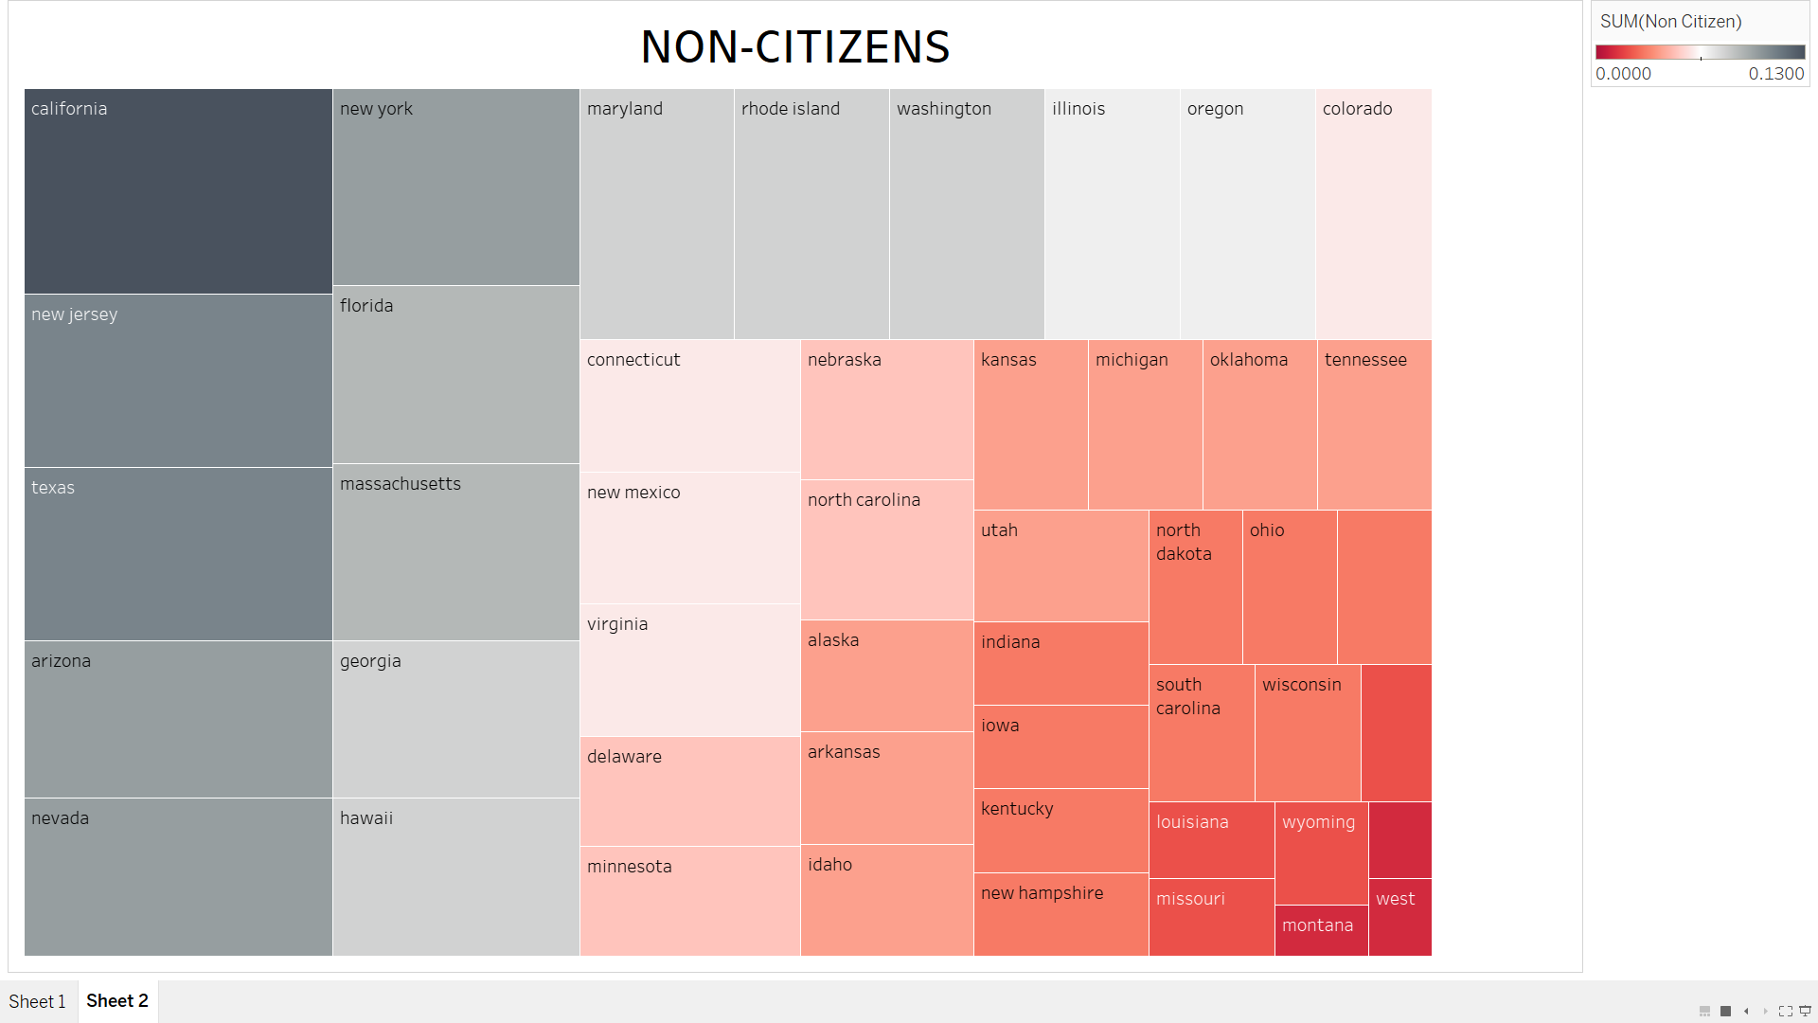

Slide 10
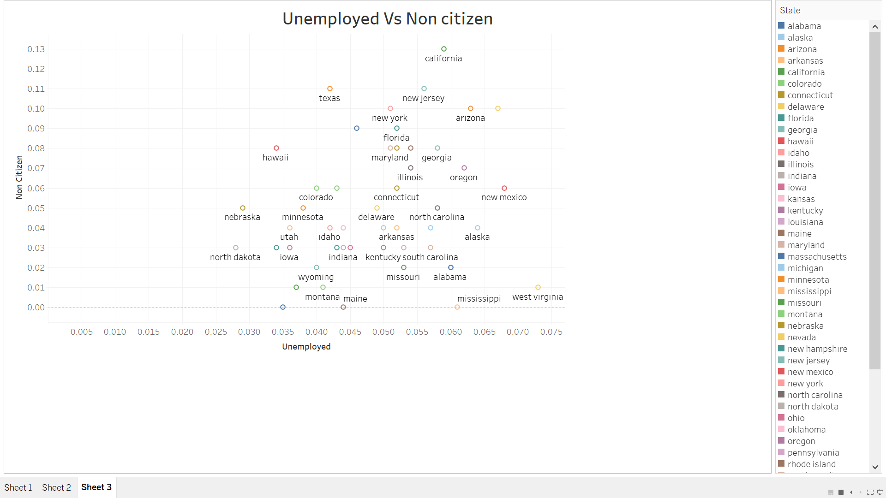

Slide 11
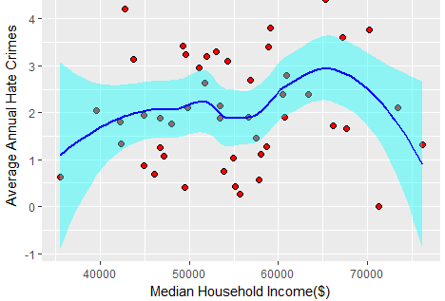
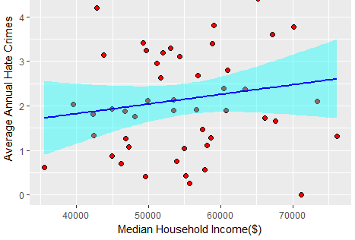
Regression plots for average hate crimes and median household income

Slide 12
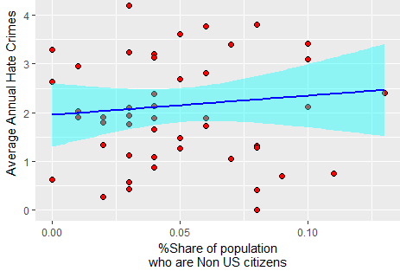
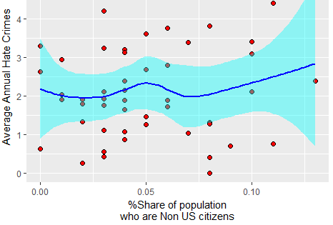
Regression plots for average hate crimes and %share of Non-US citizens

Slide 13
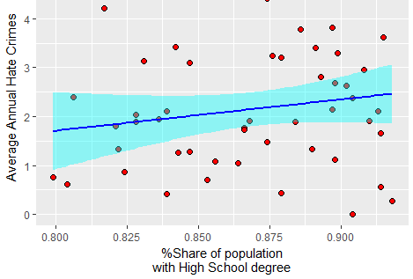
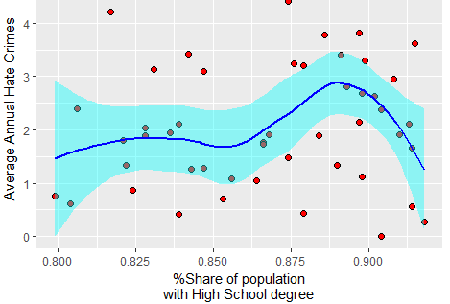
Regression plots for average hate crimes and %share of population with high_school_degree

Slide 14
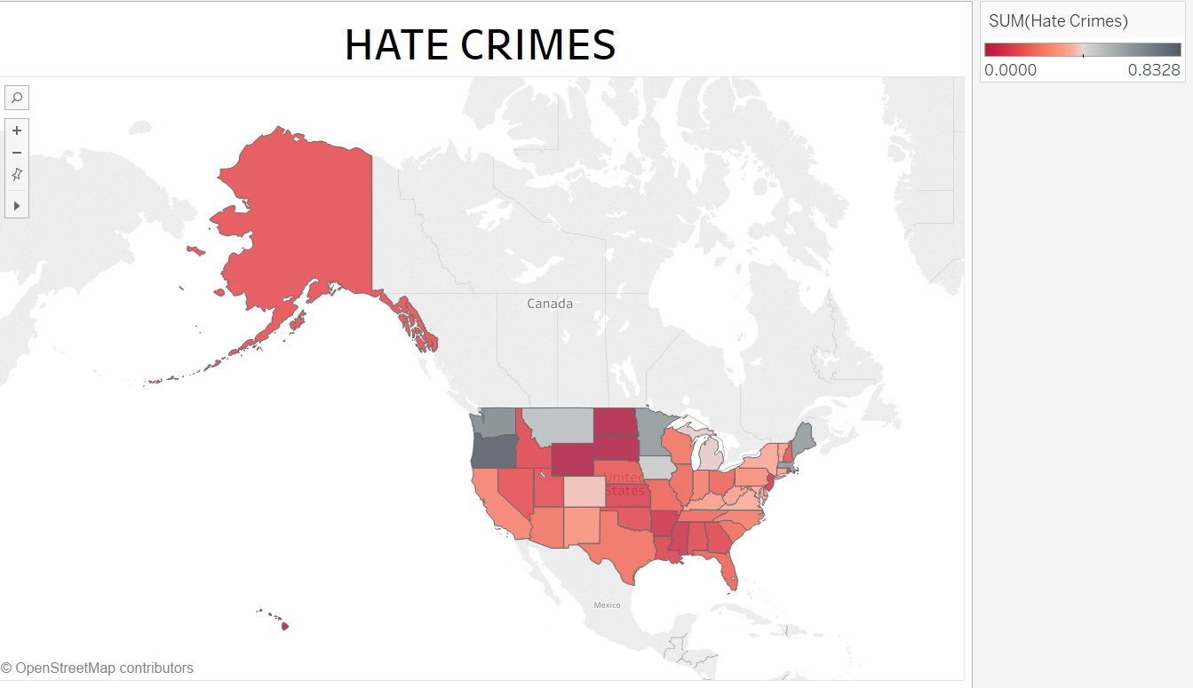

Slide 15
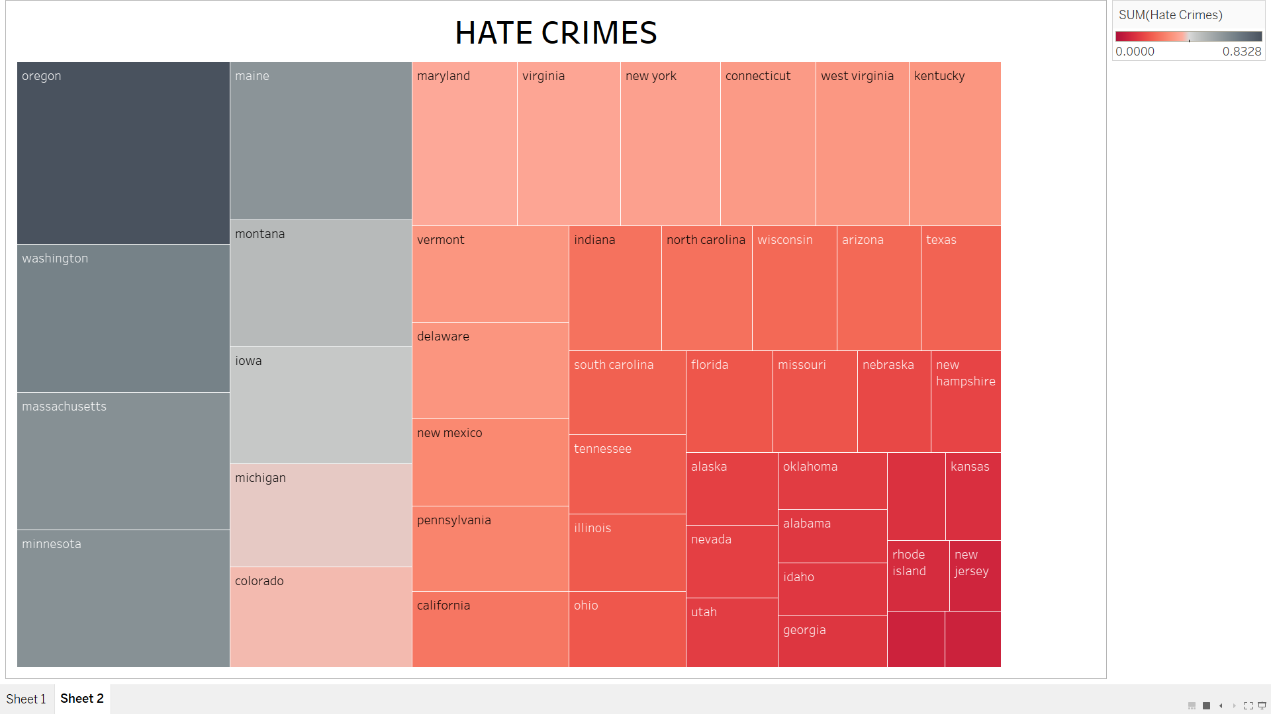

Slide 16
Conclusion:
The highly correlated predictor is % share of population with high school degree because uneducated people tend to involve in hate crimes.
Also, hate crimes occur due to very low household income.
There may be minimal influence of % share of population of metro area and non-citizens.

Slide 17
Reference:
https://github.com/fivethirtyeight/data/tree/master/hate-crimes

Slide 18


